Slide 1
Measuring the Cost of Living
© 2015 Cengage Learning. All Rights Reserved. May not be copied, scanned, or duplicated, in whole or in part, except for use as permitted in a license distributed with a certain product or service or otherwise on a password-protected website for classroom use.

Slide 2
The Consumer Price Index
Consumer price index (CPI)
  Measure of the overall level of prices
  Measure of the overall cost of goods and services
    Bought by a typical consumer
  Bureau of Labor Statistics
© 2015 Cengage Learning. All Rights Reserved. May not be copied, scanned, or duplicated, in whole or in part, except for use as permitted in a license distributed with a certain product or service or otherwise on a password-protected website for classroom use.

Slide 3
Calculating CPI
Fix the basket
  Which prices are most important to the typical consumer
  Different weight
Find the prices
  At each point in time
Compute the basket’s cost
  Same basket of goods
  Isolate the effects of price changes
© 2015 Cengage Learning. All Rights Reserved. May not be copied, scanned, or duplicated, in whole or in part, except for use as permitted in a license distributed with a certain product or service or otherwise on a password-protected website for classroom use.

Slide 4
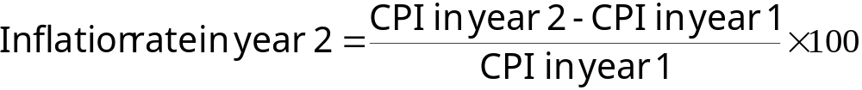
Calculating CPI
Chose a base year and compute the CPI
  Base year = benchmark
    Price of basket of goods and services in current year
    Divided by price of basket in base year
    Times 100
Compute the inflation rate
© 2015 Cengage Learning. All Rights Reserved. May not be copied, scanned, or duplicated, in whole or in part, except for use as permitted in a license distributed with a certain product or service or otherwise on a password-protected website for classroom use.

Slide 5
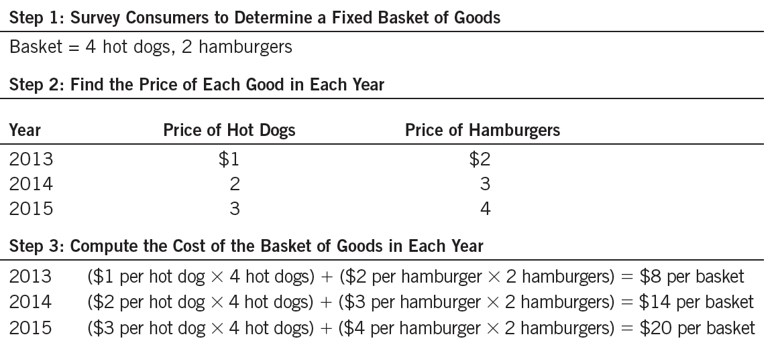
Table 1
Calculating the Consumer Price Index and the Inflation Rate: An Example
This table shows how to calculate the consumer price index and the inflation rate for a hypothetical economy in which consumers buy only hot dogs and hamburgers.
© 2015 Cengage Learning. All Rights Reserved. May not be copied, scanned, or duplicated, in whole or in part, except for use as permitted in a license distributed with a certain product or service or otherwise on a password-protected website for classroom use.

Slide 6
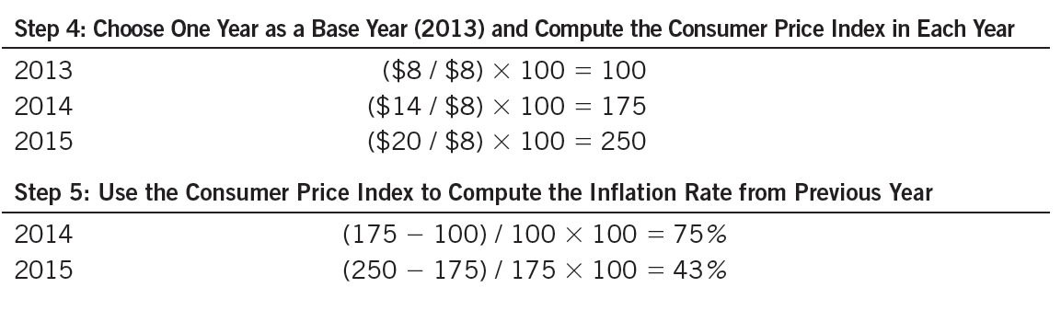
Table 1
Calculating the Consumer Price Index and the Inflation Rate: An Example
This table shows how to calculate the consumer price index and the inflation rate for a hypothetical economy in which consumers buy only hot dogs and hamburgers.
© 2015 Cengage Learning. All Rights Reserved. May not be copied, scanned, or duplicated, in whole or in part, except for use as permitted in a license distributed with a certain product or service or otherwise on a password-protected website for classroom use.

Slide 7
The Consumer Price Index
Inflation rate
  Percentage change in the price index
    From the preceding period
Producer price index, PPI
  Measure of the cost of a basket of goods and services bought by firms
  Changes in PPI are often thought to be useful in predicting changes in CPI
© 2015 Cengage Learning. All Rights Reserved. May not be copied, scanned, or duplicated, in whole or in part, except for use as permitted in a license distributed with a certain product or service or otherwise on a password-protected website for classroom use.

Slide 8
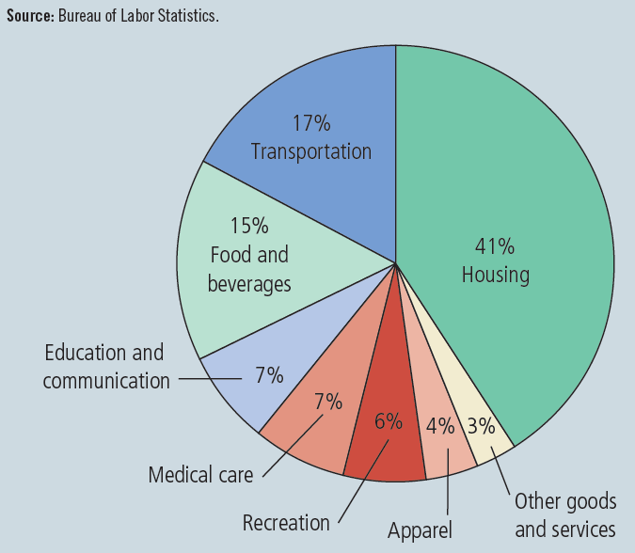
Figure 1
The Typical Basket of Goods and Services
This figure shows how the typical consumer divides spending among various categories of goods and services. The Bureau of Labor Statistics calls each percentage the “relative importance” of the category.
© 2015 Cengage Learning. All Rights Reserved. May not be copied, scanned, or duplicated, in whole or in part, except for use as permitted in a license distributed with a certain product or service or otherwise on a password-protected website for classroom use.

Slide 9
The Consumer Price Index
Problems in measuring the cost of living
  Substitution bias
    Prices do not change proportionately
    Consumers substitute toward goods that have become relatively less expensive
  Introduction of new goods
    More variety of goods
  Unmeasured quality change
    Changes in quality
© 2015 Cengage Learning. All Rights Reserved. May not be copied, scanned, or duplicated, in whole or in part, except for use as permitted in a license distributed with a certain product or service or otherwise on a password-protected website for classroom use.

Slide 10
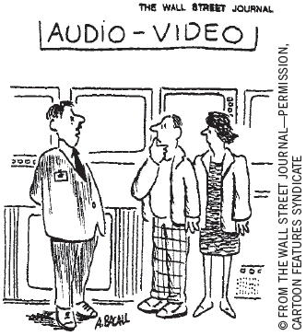
GDP deflator versus CPI
GDP deflator
  Ratio of nominal GDP to real GDP
  Reflects prices of all goods & services produced domestically
CPI
  Reflects prices of goods & services bought by consumers
“The price may seem a little high, but you have to remember that’s in today’s dollars.”
© 2015 Cengage Learning. All Rights Reserved. May not be copied, scanned, or duplicated, in whole or in part, except for use as permitted in a license distributed with a certain product or service or otherwise on a password-protected website for classroom use.

Slide 11
GDP deflator versus CPI
GDP deflator
  Compares the price of currently produced goods and services
    To the price of the same goods and services in the base year
CPI
  Compares price of a fixed basket of goods and services
    To the price of the basket in the base year
© 2015 Cengage Learning. All Rights Reserved. May not be copied, scanned, or duplicated, in whole or in part, except for use as permitted in a license distributed with a certain product or service or otherwise on a password-protected website for classroom use.

Slide 12
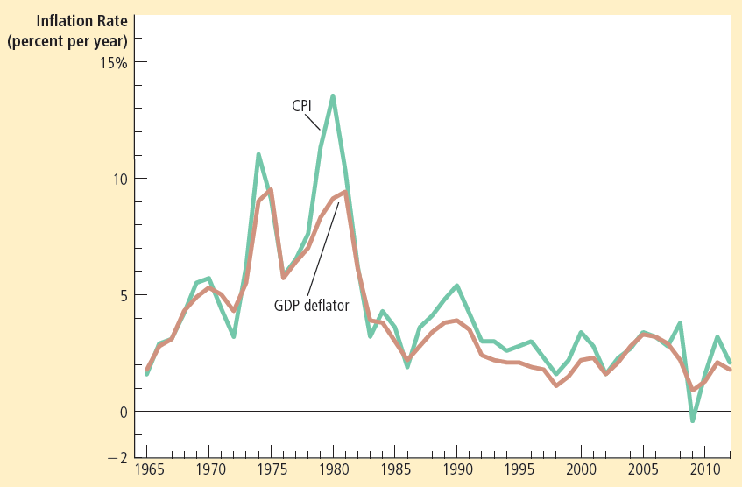
Figure 2
Two Measures of Inflation
This figure shows the inflation rate—the percentage change in the level of prices— as measured by the GDP deflator and the consumer price index using annual data since 1965. Notice that the two measures of inflation generally move together.
© 2015 Cengage Learning. All Rights Reserved. May not be copied, scanned, or duplicated, in whole or in part, except for use as permitted in a license distributed with a certain product or service or otherwise on a password-protected website for classroom use.

Slide 13
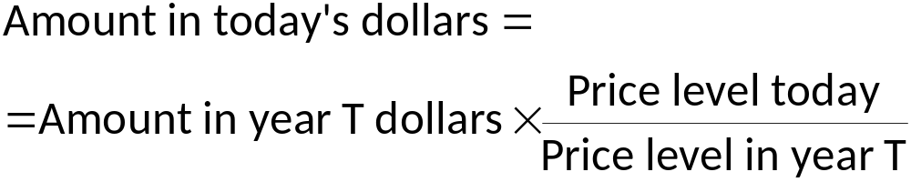
Correcting Economic Variables
Dollar figures from different times
Indexation
  Automatic correction by law or contract
  Of a dollar amount
  For the effects of inflation
  COLA: Cost of living allowance
© 2015 Cengage Learning. All Rights Reserved. May not be copied, scanned, or duplicated, in whole or in part, except for use as permitted in a license distributed with a certain product or service or otherwise on a password-protected website for classroom use.

Slide 14
Real and Nominal Interest Rates
Nominal interest rate
  Interest rate as usually reported
  Without a correction for the effects of inflation
Real interest rate
  Interest rate corrected for the effects of inflation
= Nominal interest rate – Inflation rate
© 2015 Cengage Learning. All Rights Reserved. May not be copied, scanned, or duplicated, in whole or in part, except for use as permitted in a license distributed with a certain product or service or otherwise on a password-protected website for classroom use.

Slide 15
Interest rates in the U.S. Economy
Nominal interest rate
  Always exceeds the real interest rate
  U.S. economy has experienced rising consumer prices in every year
Inflation is variable
  Real and nominal interest rates do not always move together
Periods of deflation
  Real interest rate exceeds the nominal interest rate
© 2015 Cengage Learning. All Rights Reserved. May not be copied, scanned, or duplicated, in whole or in part, except for use as permitted in a license distributed with a certain product or service or otherwise on a password-protected website for classroom use.

Slide 16
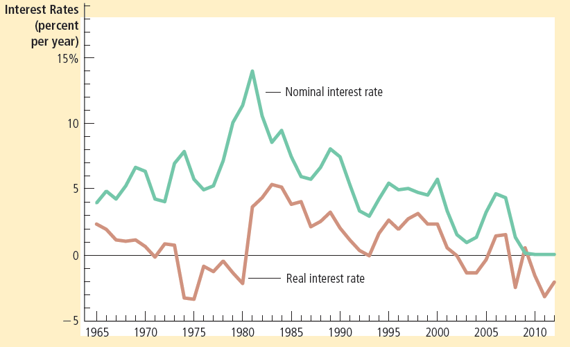
Figure 3
Real and Nominal Interest Rates
This figure shows nominal and real interest rates using annual data since 1965. The nominal interest rate is the rate on a 3-month Treasury bill. The real interest rate is the nominal interest rate minus the inflation rate as measured by the consumer price index. Notice that nominal and real interest rates often do not move together.
© 2015 Cengage Learning. All Rights Reserved. May not be copied, scanned, or duplicated, in whole or in part, except for use as permitted in a license distributed with a certain product or service or otherwise on a password-protected website for classroom use.

